Slide 1
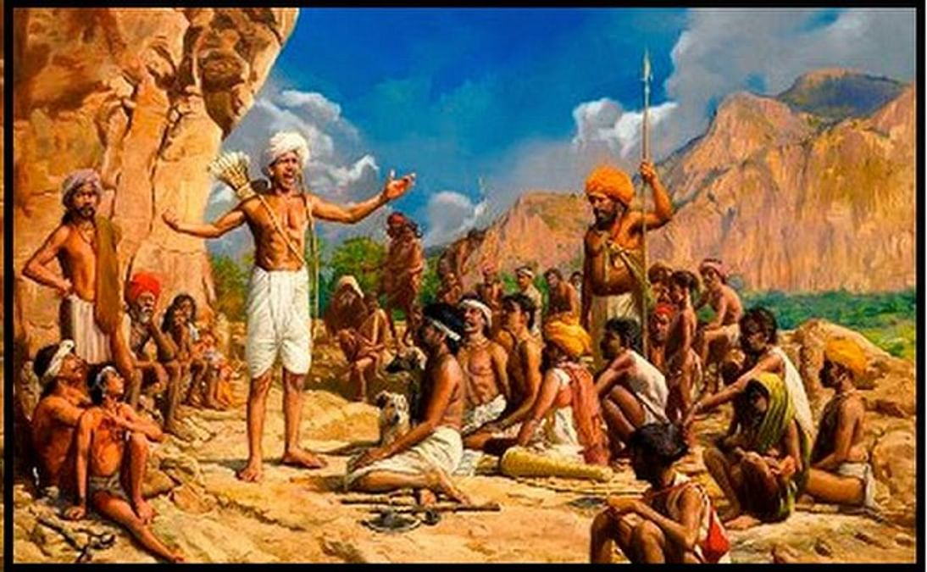
Role Of Tribal
Uprising
in India
By Imtiyaz Allam

Slide 2

Introduction
The Role of tribal Uprising in India is a topic that explores the history and significance of various rebellions and movements led by the tribal communities against British Colonial rule. These Uprising were not only expressions of resistance and dissent, but also of solidarity and nationalism among the tribal people. They challenged the oppressive and exploitative policies of the British that threatened their lands, cultures and identities. They also inspired and influenced the mainstream freedom struggle and weakened the colonial authority in many regions. The role of tribal uprising in India is therefore an important aspect of understanding the diversity and complexity of India’s independence movement.

Slide 3
Historical backdrop of Indian Freedom Struggle
The Indian Freedom Struggle was a long process of resistance against the British colonial Rule, which began with the revolt of 1857 and ended with the independence of India in 1947. The tribal uprising was a series of revolts and rebellions by various tribal communities who opposed the British policies that violated their rights, culture, and identity. The tribal uprising was one of the earliest forms of resistance against the British and it continued throughout the 18th and 19th centuries.

Slide 4
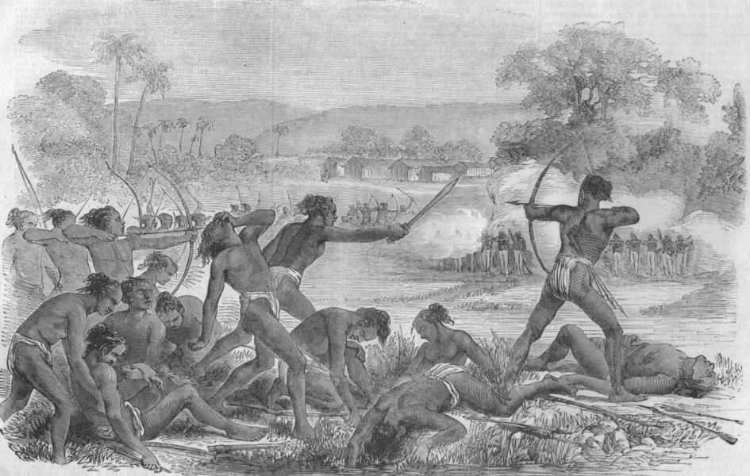
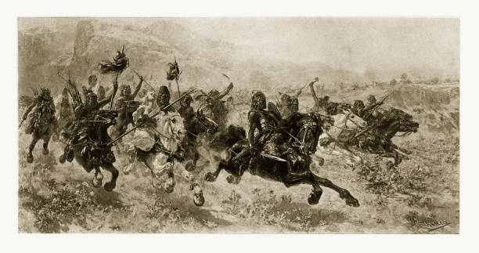
Some of the major tribal uprising that occurred during the Indian Freedom Struggles

Slide 5
Some of the major tribal uprising that occurred during the Indian Freedom Struggles
The Munda Uprising(1899-1900)
In present day Jharkhand and Odisha, led by Birsa Munda

Slide 6
Some of the major tribal uprising that occurred during the Indian Freedom Struggles
The Santhal Rebellion(1855-56)
In present day Jharkhand and West Bengal, led by Sidhu and Kanhu Murmu
The Munda Uprising(1899-1900)
In present day Jharkhand and Odisha, led by Birsa Munda

Slide 7
Some of the major tribal uprising that occurred during the Indian Freedom Struggles
The Kol Rebellion (1831-32)
In the Chhota Nagpur Plateau, led by Buddhu Bhagat, Madara Mahato, and Joa Bhagat
The Santhal Rebellion(1855-56)
In present day Jharkhand and West Bengal, led by Sidhu and Kanhu Murmu

Slide 8
Impact of Tribal uprising in Indian Freedom Struggle
They Challenged the British authority:
Tribal uprising showed that the British were not invincible, and the Indians were willing to fight for their freedom. This inspired other Indians to join the freedom struggle.
They Increased awareness of tribal issues:
Tribal uprisings brought attention to the plight of tribal communities and the injustices they were facing under British rule. This helped to build support for tribal rights and contributed to the development of a nationalistic movement that included all Indians, regardless of caste or tribe.

Slide 9
Impact of Tribal uprising in Indian Freedom Struggle
They united the Indian people:
Tribal uprisings brought together people from different region and backgrounds to fight for a common cause. This helped to promote national unity and solidarity.
They weakened the British position:
Tribal uprisings diverted British resources and attention away from other areas of the freedom struggle. This made it more difficult for the British to maintain their control over India.

Slide 10
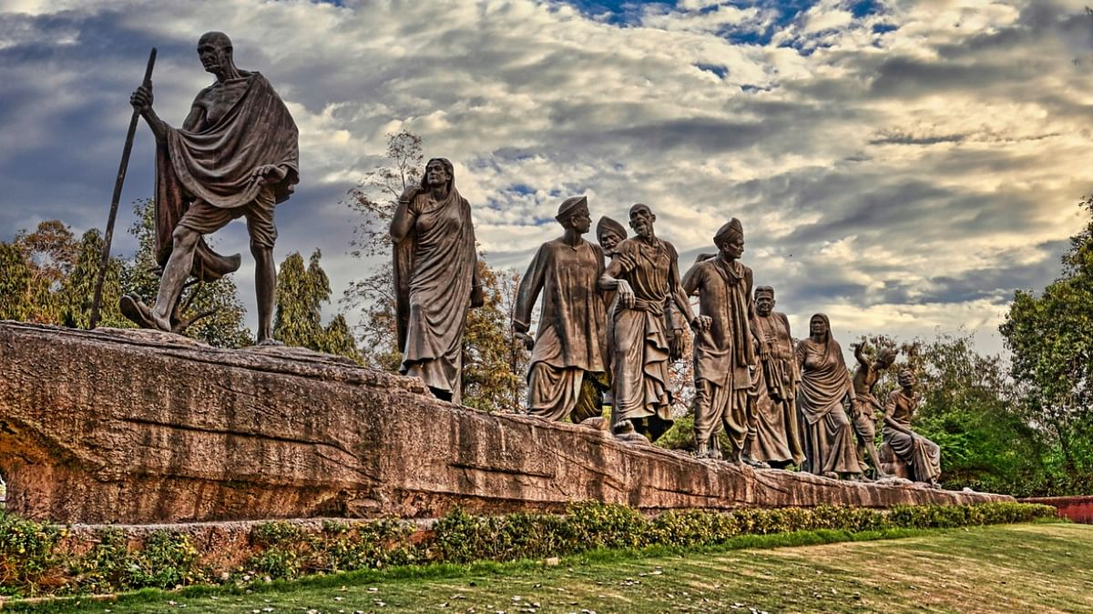
Impact of Tribal uprising in Indian Freedom Struggle
The tribal uprising inspired and influenced the nationalist leaders like Mahatma Gandhi, Jawaharlal Nehru, Subhas Chandra Bose, and other to support the tribal cause and incorporate them into the mainstream movement.

Slide 11
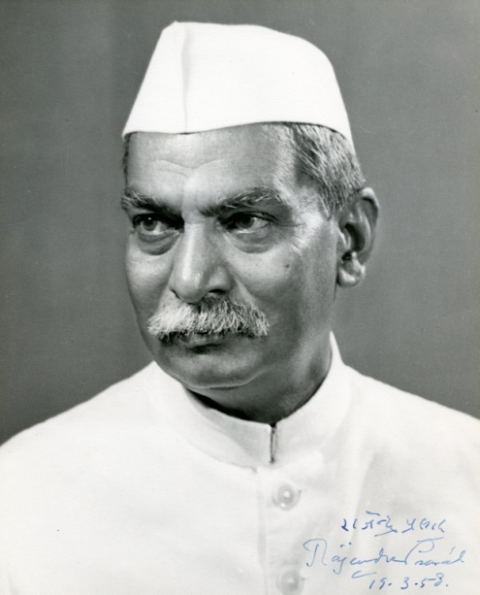
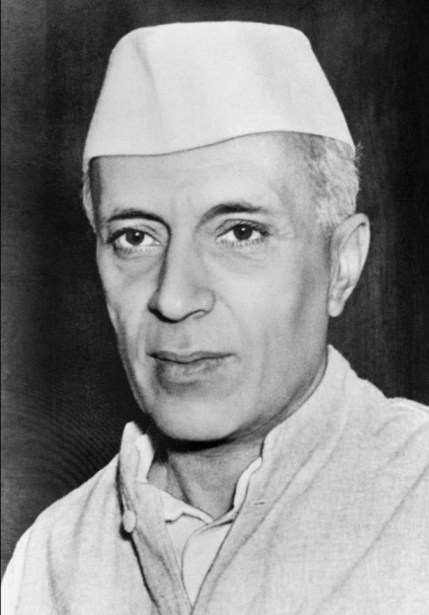
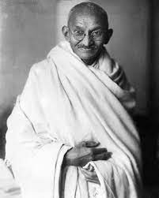
Collaboration of tribal group with mainstream freedom fighter
Tribal groups collaborated with mainstream freedom fighters like Mahatma Gandhi, Jawaharlal Nehru and Rajendra Prasad in a number of ways.
Dr. Rajendra Prasad
Pt. Jawaharlal Nehru
Mahatma Gandhi

Slide 12
Collaboration of tribal group with mainstream freedom fighter
Some of the key areas of collaboration include:
Providing Logistical support:
Tribal groups provided logistical support to mainstream freedom fighter in the form of food, shelter, and transportation. They also helped to smuggle weapons and other supplies to freedom fighter.
Participating in mass movements:
Tribal groups participated in mass movement such as the Civil Disobedience Movement and the Quit India Movement. They also organized their own protests and demonstrations against British rule.

Slide 13
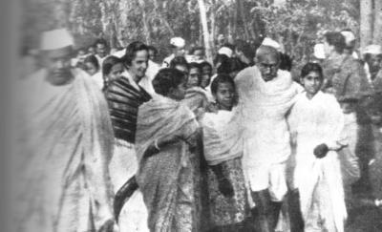
Collaboration of tribal group with mainstream freedom fighter
Some of the key areas of collaboration include:
Launching armed struggles:
Some tribal groups launched armed struggles against the British. These struggles were often coordinated with the mainstream freedom fighters.

Slide 14
Challenges Faced by tribal uprising
Tribal uprisings face a number of challenges, including:
Lack of resources:
Tribal communities are often marginalized and impoverished, and they lack the resources to sustain a prolonged uprising.
Military Disadvantages:
Tribal uprisings are often poorly armed and equipped and they are at a military disadvantage against the government.
Government repression:
Governments often responded to tribal uprising with repression, including violence, mass detentions, and forced displacement.
Internal Division:
Tribal communities are often divided along internal lines, such as clan or religious affiliations. This can make it difficult to maintain a united front against the government

Slide 15
Government’s Response
The government response to tribal uprising has varied over time and from place to place. In some cases, government have used violence and repression to crush tribal uprisings. In other cases government have been more willing to negotiate with tribal groups and address their concerns.
In recent years, there has been a growing trend towards more peaceful and negotiate settlements of tribal uprisings. This is due to number of factors:
Increased awareness of tribal rights
The rise of international human rights law
The success of negotiated statements

Slide 16
Lasting impact of tribal uprising on Indian cultures and identity
Tribal uprising have had a lasting impact on Indian culture and identity. They have helped to shape the country’s political landscape, Social Fabric and cultural expression.
Political impact:
Tribal uprising have played a significant role in the development of Indian democracy. They have forced the government to address the grievances of tribal communities and have led to the enactment of laws and policies that protect their rights.
Social impact:
Tribal uprising have also had a major impact on Indian society. They have helped to raise awareness of plight of tribal communities and have led to a greater appreciation of their unique culture and tradition.

Slide 17
Lasting impact of tribal uprising on Indian cultures and identity
Social impact:
Tribal uprisings have also had a major impact on Indian Society. They have helped to raise awareness of the plight of tribal communities and have led to a greater appreciation of their unique cultures and traditions.

Slide 18
Examples of the lasting impact of tribal uprising on
Indian culture and identity
Santhal Rebellion of 1855-56 led to the establishment of the Santal Parganas district, a special administrative unit for the Santhal People.

Slide 19
Examples of the lasting impact of tribal uprising on
Indian culture and identity
The Munda Rebellion of 1899-1900 led to the enactment of the Chotanagpur Tenancy Act which protected the tribal tenats. It even inspired the Indian Independence movement and is considered to be one of the earliest examples of anti-colonial resistance in india
Santhal Rebellion of 1855-56 led to the establishment of the Santal Parganas district, a special administrative unit for the Santhal People.

Slide 20
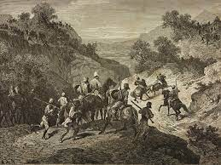
Examples of the lasting impact of tribal uprising on
Indian culture and identity
The Munda Rebellion of 1899-1900 led to the enactment of the Chotanagpur Tenancy Act which protected the tribal tenats. It even inspired the Indian Independence movement and is considered to be one of the earliest examples of anti-colonial resistance in india
The Bhil Revolt of 1921-22 led to the establishment of the Bhil Agency, a special administrative unit for the Bhil people

Slide 21
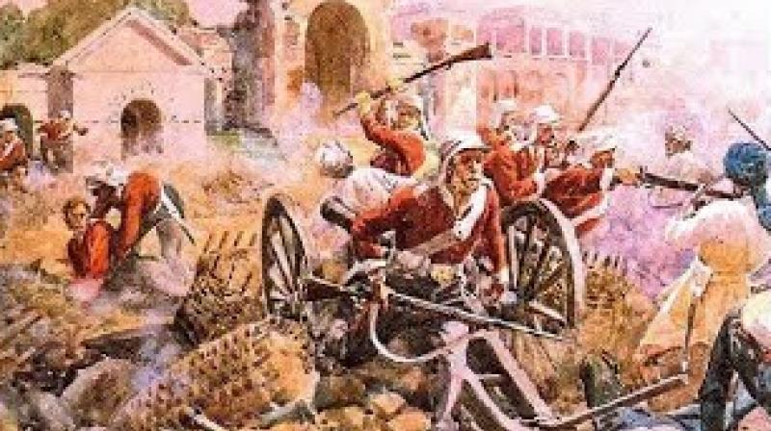
Examples of the lasting impact of tribal uprising on
Indian culture and identity
The Bhil Revolt of 1921-22 led to the establishment of the Bhil Agency, a special administrative unit for the Bhil people
The Rampa Rebellion of 1922-24 led to the formation of the Adivasi Mahasabha, a political organization that represented the interests of tribal communities

Slide 22
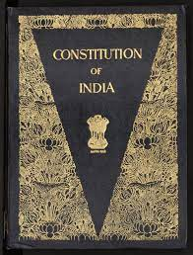
How tribal issues were addressed post-independence?
The Indian government has taken a number of steps to address tribal issues post-independence. These include:
Constitutional safeguard:
The Indian constitution includes a number of safeguards for tribal communities, such as reservations in government jobs and educational institutions and the creation of autonomous tribal councils in some areas

Slide 23
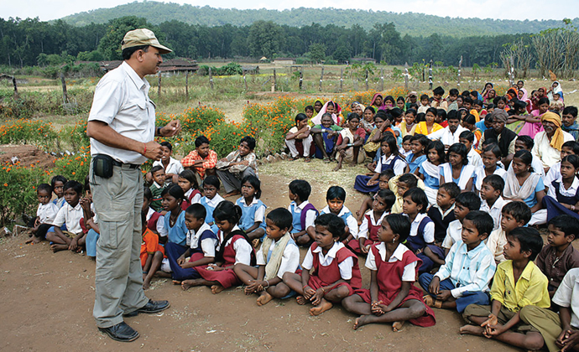
How tribal issues were addressed post-independence?
The Indian government has taken a number of steps to address tribal issues post-independence. These include:
Constitutional safeguard:
The Indian constitution includes a number of safeguards for tribal communities, such as reservations in government jobs and educational institutions and the creation of autonomous tribal councils in some areas
Development programs:
The government has implemented a number of development programs aimed at improving the lives of tribal peoples. These programs focus on areas such as education, healthcare, employment and infrastructure development
Education given to tribal children

Slide 24
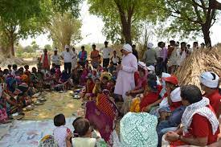
How tribal issues were addressed post-independence?
The Indian government has taken a number of steps to address tribal issues post-independence. These include:
Legislative measures:
The government has enacted a number of laws to protect the rights of tribal communities. These laws include the Scheduled Tribes and other Traditional Forest Dwellers Act, 2006, which recognizes the forest rights of tribal communities, and the Panchayats Act, 1996, which gives greater powers to gram sabhas in tribal areas
Development programs:
The government has implemented a number of development programs aimed at improving the lives of tribal peoples. These programs focus on areas such as education, healthcare, employment and infrastructure development
Gram Panchayat

Slide 25
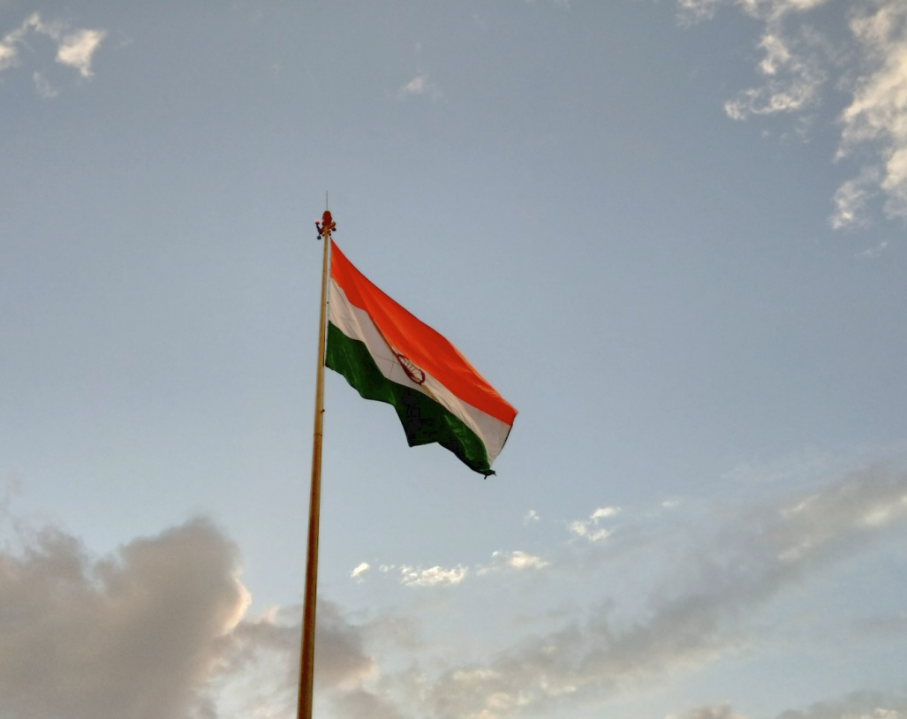
Conclusion
The legacy of these tribal uprising is still alive today, as many tribal communities continue to struggle for their rights, identity, and dignity. Their role in Indian Freedom Struggle is a remarkable story of courage, resilience and resistance. It is a story that deserves to be remembered and honored by all Indians

Slide 26


